Slide 1

INTRODUCTION

Slide 2
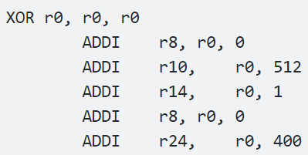
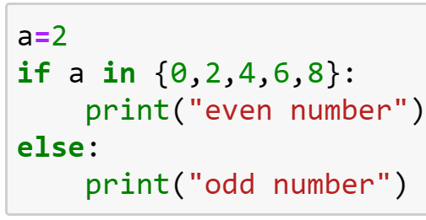
What is Python?
Python is an
High-level programming language
General-purpose programming language
Interpreted programming language
Let’s make a few comparisons:
Low Level vs. High Level:
General Purpose vs. Targeted
Interpreted vs. Compiled

Slide 3
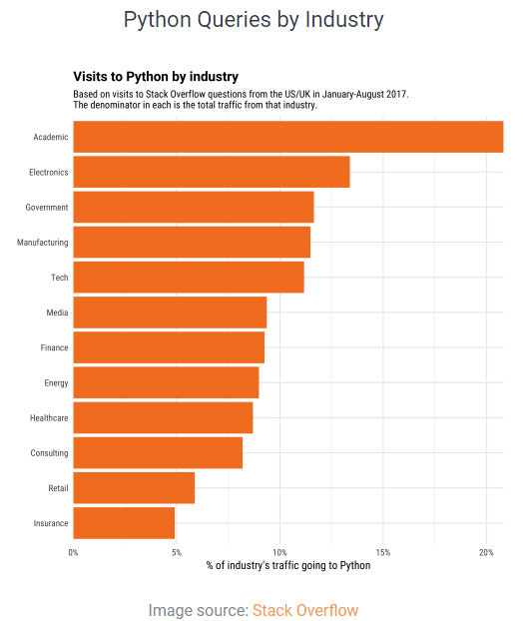
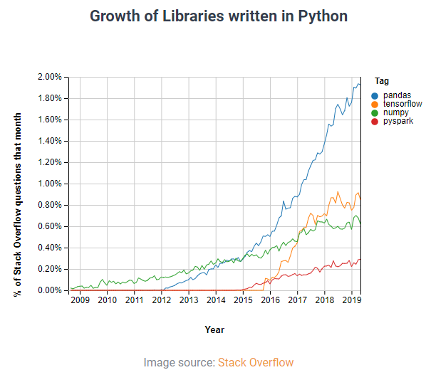
Why Python?
(see https://codingnomads.co/blog/business/why-learn-python/)
Python uses in other industries
Python is versatile: Python is used in Data Mining, Data Science, AI, Machine Learning, Web Development, Web Frameworks, Embedded Systems, Graphic Design applications, Gaming, Network development, Product development, Rapid Application Development, Testing, Automation, the list goes on.
Python uses in data science

Slide 4
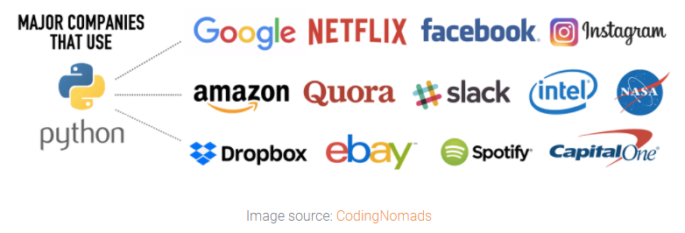
Why Python?
What types of companies use Python?

Slide 5
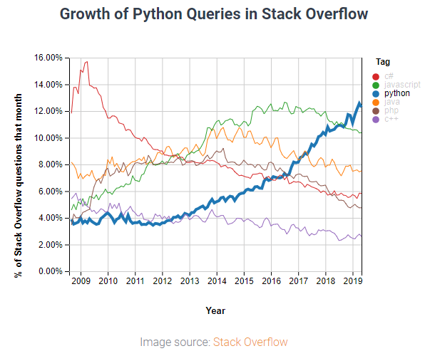
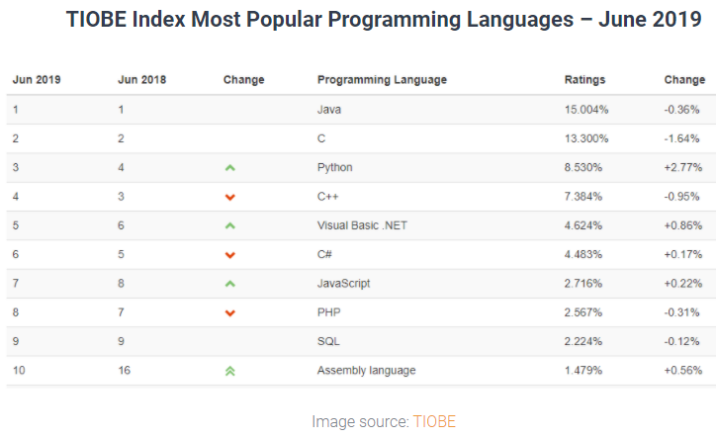
Why Python?
Python is the fastest growing programming language

Slide 6
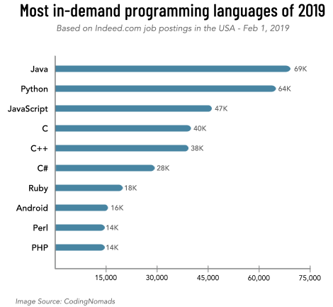
Why Python?
Python tops the list of the most in-demand programming languages

Slide 7
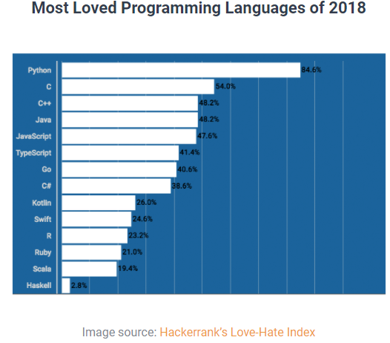
Why Python?
Python is easy to read, write, and learn

Slide 8
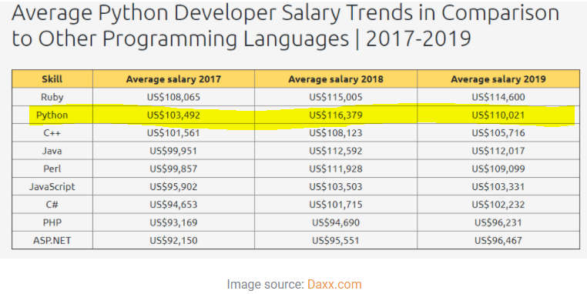
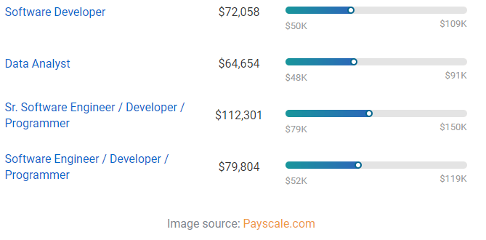
Why Python?
Python developers make great money

Slide 9
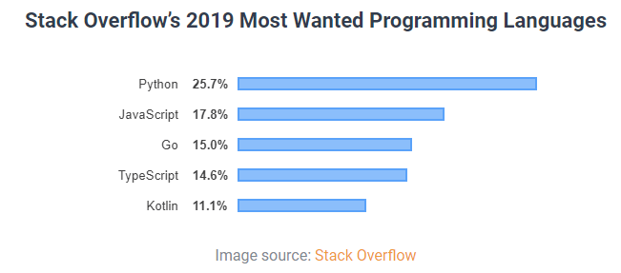
Why Python?
Python has an incredibly supportive community
Stack Overflow is a programming question and answer platform critical for all developers when they are stuck, or wanting to share wisdom with the community
GitHub is where developers store project code and collaborate with other developers
Open source packages
Python offers a rich ecosystem of packages held within The Python Package Index (PyPI)

